Slide 1
Entities, Symbols, and Encoding
Module 6

Slide 2
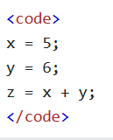
HTML Computercode
HTML contains several elements for defining user input and computer code

Slide 3

<kbd> For Keyboard Input
The <kbd> element is used to define keyboard input
The content inside it is displayed in the browser’s default monospace font

Slide 4
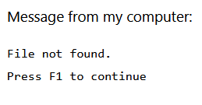

<samp> for Program Output
The <samp> element is used to define sample output from a program
The content is displayed in the browser’s default monospace font

Slide 5
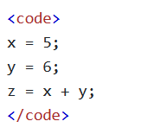

<code> for Computer Code
The <code> element is used to define a piece of computer code
The content inside is displayed in the browser’s default monospace font
This will not preserve the whitespace or line-breaks. That requires a <pre> element

Slide 6
<var> For Variables
<var> is used for defining a variable in programming or math
The content inside it is displayed in italics

Slide 7
Entities

Slide 8
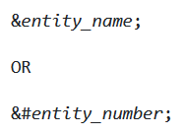
HTML Entities
Some characters in HTML are reserved
For example, greater than or less than signs may be confused with opening and closing tags
Character entities are used to display reserved characters

Slide 9
Non-breaking Space
Non-breaking spaces are spaces that will not break into a new line
One of the most common entities
This can be useful keeping Numbers and their Units together, like 10 mph or 8 Gb/s
This entity can prevent spaces from being truncated

Slide 10
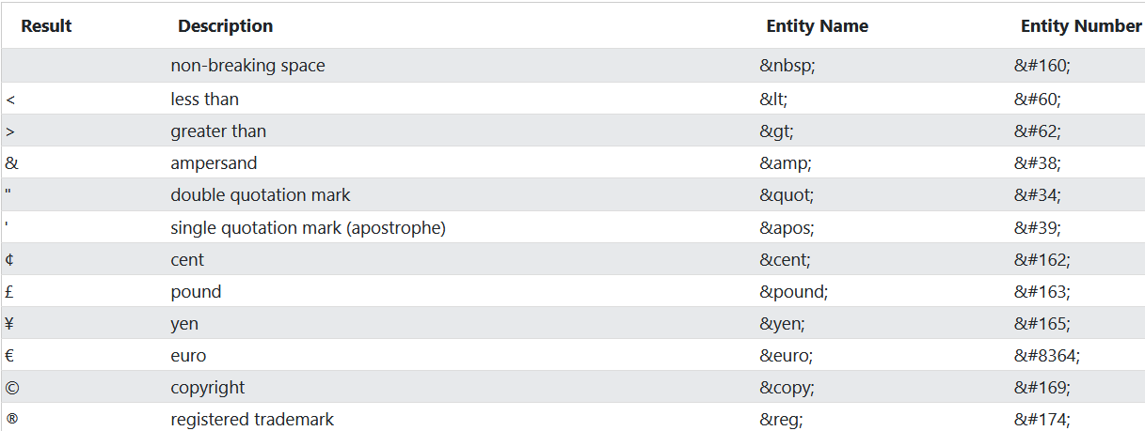
Some Useful Character Entities

Slide 11
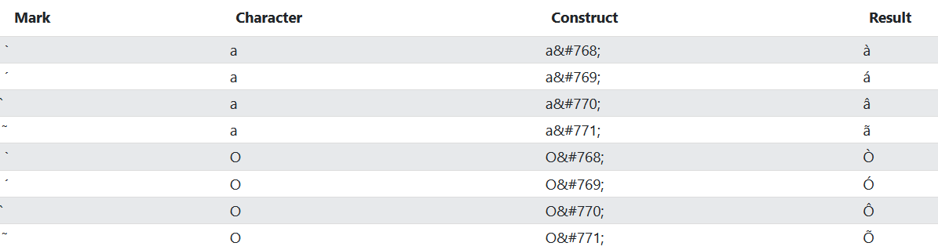
Combining Diacritical Marks
Diacritical Marks are “glyphs” that get added to a letter, like the tilde of ñ
Some marks can be called accents, like `
These marks can appear above, below, inside, or between letters

Slide 12
Symbols

Slide 13


Symbol Entities
Symbol Entities are similar to character entities, but used for currencies, mathematical symbols, and technical symbols that don’t exist on a keyboard
To add such symbols to an HTML doc, you can use the entity name or number (usually a hexadecimal)

Slide 14
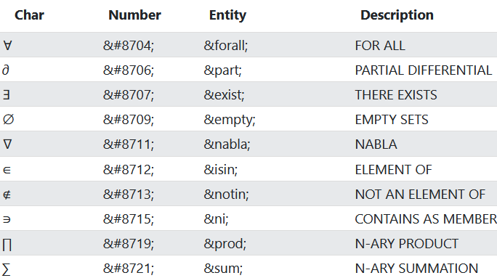
A List of Symbols

Slide 15
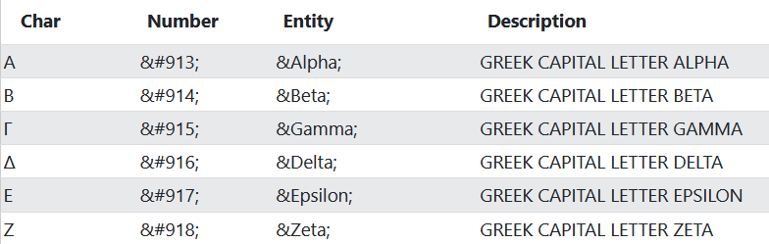
Greek Letters are Supported

Slide 16
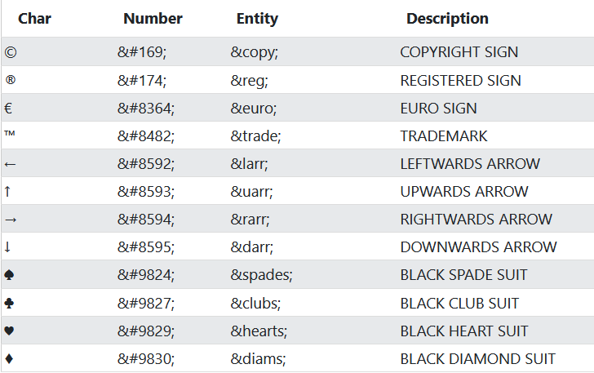
Other Entities

Slide 17
Emojis

Slide 18
What Are Emojis?
Emojis look like tiny images or icons, but they are not
They are actually encoded from the UTF-8 (Unicode) character set
UTF-8 includes nearly characters of every written language

Slide 19

The HTML charset Attribute
Browsers need to know which characters to use in order to load a webpage
This is why we have to add the charset to a meta element

Slide 20
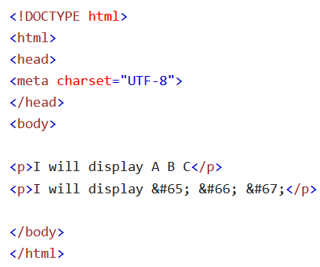

UTF-8
There are ~150,000 possible characters in UTF-8
However, our keyboards can only fit around 100 characters
We can access the rest of these characters using numbers known as entity numbers
Notes:
Unicode Transformation Format

Slide 21

UTF-8
The syntax for using entity numbers if &#number;
Example:

Slide 22

Emoji Characters
Emojis are actually characters in UTF-8
Just like all other characters, emojis can be copied, resized, and displayed

Slide 23
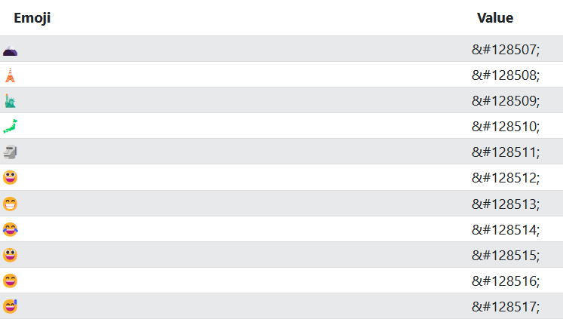
A List of Emojis

Slide 24
HTML Charset

Slide 25
ASCII to UTF8
ASCII was the first character encoding set and only had 128 characters, all of which were English.
There were several that came after than, including ISO-8859-1 and ANSI, both of which added more characters but suffered the same problems as ASCII
In the 90s, UTF-8 was developed, allowing our applications to work across all languages

Slide 26
Differences Between Charsets
None of the charsets are identical, but however large ranges of each charset are
They kept the same sequence in order to build off of ASCII

Slide 27
ASCII
ASCII uses values 0 – 31 and 127 for control characters, like punctuation
32+ are all letters, numbers, and symbols
127 is the max value, which makes ASCII very efficient (only 7 bits per character)

Slide 28
ANSI (Windows-1252)
ANSI and ASCII are the same up to 127
ANSI has proprietary characters from 128 to 159, like the double dagger
ANSI and UTF-8 are the same from 160-255

Slide 29
ISO-8859
Identical to ASCII from 0 – 127
Does not use 128 – 159
Identical to UTF-8 from 160-255
Notes:
ISO = International Organization for Standardization (Switzerland, 1947)

Slide 30
UTF-8
Identical to ASCII from 0 – 127
Doesn’t use 128-159 (ANSI/Microsoft owned)
Identical to ANSI and ISO from 160 – 255
Continues after 256 with thousands of different characters

Slide 31
URL Encode

Slide 32
URL – Uniform Resource Locator
Browsers request pages from web servers using URLs
A Uniform Resource Locator (URL) is used to address a document or other data on the web
Follows this syntax:

Slide 33
URL Syntax
Scheme: the type of internet service, often protocol (usually http or https)
Prefix: the domain prefix (default for http is www)
Domain: The internet domain name of an ip address

Slide 34
URL Syntax
Port: Defines a port number at the host server (defaults: 80 – http, 443 – https)
Path: File path to file on the server (no path if the file is in the root directory)
Filename: Defines name of document/resource

Slide 35
Common URL Schemes
http: HyperText Transfer Protocol – Used for common web pages (unencrypted)
https: HyperText Transfer Protocol Secure – Used for secure web pages (encrypted)
ftp: File Transfer Protocol – Downloading/uploading files
file: A file on your computer displayed in a browser

Slide 36
URL Encoding
URLs can only be sent over the internet using ASCII, so any UTF must be converted
URL Encoding converts non-ASCII characters to a format they can be transferred in

Slide 37
URL Encoding
URL encoding replaces non-ASCII characters with a %, followed by a hexadecimal value
URLs cannot have spaces
They often replace spaces with either a +, or a %20

Slide 38
HTML vs XHTML

Slide 39
What is XHTML?
XHTML: Extensible HyperText Markup Language
It is a more stricter, more XML based version of HTML
XHTML is dated – mostly used with HTML4, released in 2000

Slide 40
Why Use XHTML?
XML is a markup language that requires all documents to be “well formed”
XHTML is designed to be used with XHTML
Browsers are generally very forgiving of errors in HTML, but XHTML requires strict conformity so it can be used with XML
Notes:
Well formed – correct markup

Slide 41
XHTML vs HTML
<!DOCTYPE> is mandatory
<html> element has a mandatory xmlns attribute
You must have a <html>, <head>, <title>, and <body> element

Slide 42
XHTML vs HTML
Elements must always be properly nested
Every element must be closed
Elements must be in lowercase

Slide 43
XHTML vs HTML
Attribute names must be in lowercase
Attribute values must be quoted
Attribute minimization is forbidden

Slide 44
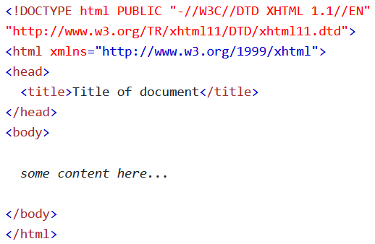
Mandatory <!DOCTYPE>
<!DOCTYPE> must always be declared for XHTML, along with <html>, <head>, <title>, and <body> elements
The <html> element must specify the xml namespace

Slide 45


Proper Nesting
XHTML elements must be properly nested
Elements must be closed in a FILO order (first in last out)

Slide 46


XHTML Elements Must Always Be Closed
Unlike HTML, XHTML will not forgive you for not closing an element

Slide 47
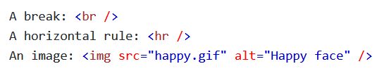
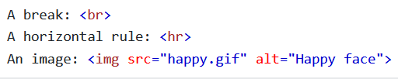
XHTML Empty Elements Must Be Closed
In XHTML, you must close empty elements

Slide 48


Elements Must Be Lower Case
Elements can only be in lower case

Slide 49
Attribute Names Lower Case
Attribute names must also be lower case

Slide 50
Attribute Values Must Be Quoted
All attribute values must be quoted, not just attribute values with a space

Slide 51


Attribute Minimization is Forbidden
Attribute values cannot be minimized

